Slide 1
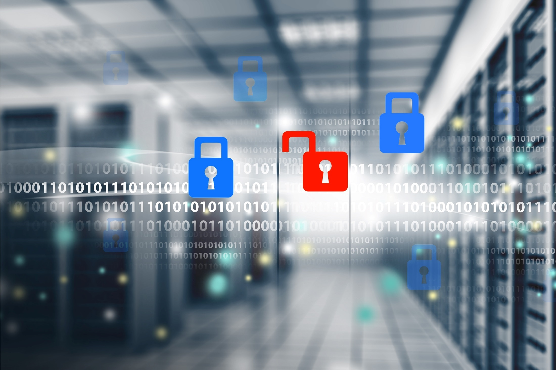


System Hardening without Affecting Production Services
Presented by:
Adam the Automator

Slide 2

About the Author
Pluralsight Author
PowerShell Trainer
Freelance Writer
PowerShell Consultant
Blog: adamtheautomator.com
Twitter: @adbertram
Microsoft Cloud/ Datacenter Management MVP

Slide 3

The Cards are Stacked Against Good Guys
0 day attacks
Phishing
Malware
Forgetful admins
Notes:
The IT security industry has always been a game of cat and mouse. The bad guys are constantly coming up with new ways to exploit vulnerabilities in your business. The good guys are then fixing these vulnerabilities as fast as possible and coming up with new ways to protect themselves.
Unfortunately, the cards are stacked against the good guys. Why? It's because it's much easier to look for flaws in a system and exploit them rather than to protect the system as a hole. All a bad guy needs is a single point of entry. That entry doesn't even need to be some complicated malware like Stuxnet, for example. It could simple be Susie in HR getting an email that says she's the lucky beneficiary of that price in Nigeria!
The good guys have to worry about all the technical attacks like ***0-day attacks, ***intelligent malware, ***viruses, worms, etc. They also though have to worry about the human element; the ***Susies of the world plus forgetful or inexperienced admins that leave network and server configurations wide open to the world or simply don't keep the firmware or software up to date from the manufacturer.
Nowadays, it's becoming more common for security professionals to simply assume that a breach has occurred and put forth a plan to mitigate the impact rather than trying to prevent all attacks. This is the state of the industry now, unfortunately.

Slide 4

Installing Software isn't Enough
Start with a hard foundation
Secure by default
Then install software
Notes:
I remember when I just got started in my career in IT, it was considered good enough to have a locked down network perimeter with a firewall preventing incoming traffic. In addition, we'd ensure that we had antivirus software on all servers and computers and ensured that we kept the virus definitions up to date.
Nowadays, that's not near enough. It's important to first ***start with a hard foundation and work from there. It's important to first remove any feature that's not necessary. ***This is to reduce your attack surface. Of the features you do need, you'll then need to harden your operating system itself. For example, Windows is an extremely complicated operating system. Unfortunately, what comes with that complexity is an inherently less secure system. This is one of the reasons they're releasing server products like Nano Server.
Most admins know this and try their best but once they get into a group policy object for example and start looking around, they soon become overwhelmed with the number of policies that exist and things that can be modified. On top of that, it takes a full-time security professional to really understand all of those changes.
If you're able to survive the OS hardening task it's then and only then you should begin to ***rely on third party software for protection like host-based antivirus,malware protection, etc.

Slide 5








System Hardening is Mandatory
What is system hardening?
Why harden servers?
@adbertram
Notes:
What I alluded to in the last slide was system hardening. ***System hardening can means lots of different things but when I think of system hardening I think of eliminating as much extra "stuff" as possible on a server that's not of use. This reduces the attack surface. I also think of system hardening as doing research and figuring out what out-of-the-box settings need to be applied out of the box in order to call a system "secure".
System hardening is about following best practice guides or scanning your systems with vulnerability scanners to find out of date machines with known exploits. Also, it means testing these proposed changes in test environments and if they look good, making configuration changes to your systems in order to reduce the risk as much as possible of it being compromised.
You probably already know what you SHOULD harden your servers but ***why? This might sound obvious at first; to make them more "SECURE", right? Well, what "secure" means to a sysadmin is probably different than what secure means to a security architect or a business professional.
Let's go over three reasons why why you need to harden your systems and get a glimpse into what "secure" might mean to different categories of people.

Slide 6



Reason #1: Compliance
Auditors
Fines
Happy Mgmt
Notes:
The first reason to harden your system is compliance. Most of us either are or had to deal with some form of compliance tasks in our career. Although, it's not necessarily a fun task to prove yourself to anyone it's a necessary evil when faced with inadequate security measures being taken by some companies. An overseer is required.
***Auditors love that magic word; in compliance. The truth is, everyone does. ***Proving that is another story. One of the main reasons why no one likes compliance is because it's been hard to define. Since most compliance agencies don't release strict requirements, it's up to you and the auditors to come to the conclusion if you're truly in compliance or not.
However, even if these regulatory bodies WOULD release specific requirements, most businesses would still be hating life when the auditors come into town. Why? It's because they don't have the tools in place to quickly discover all the information they need to bring to the auditors.
Nine times out of 10, when I've been asked to provide some report for an auditor, it always ends with a grimace. It's because it's usually going to require a lot of extra effort because I haven't taken put a system in place to gather that information ahead of time.
There are plenty of tools out there that allow you to harden systems and provide reports out of the box that can be run at will. ***These reports can then be handed to the auditors, and they can be on their way.

Slide 7
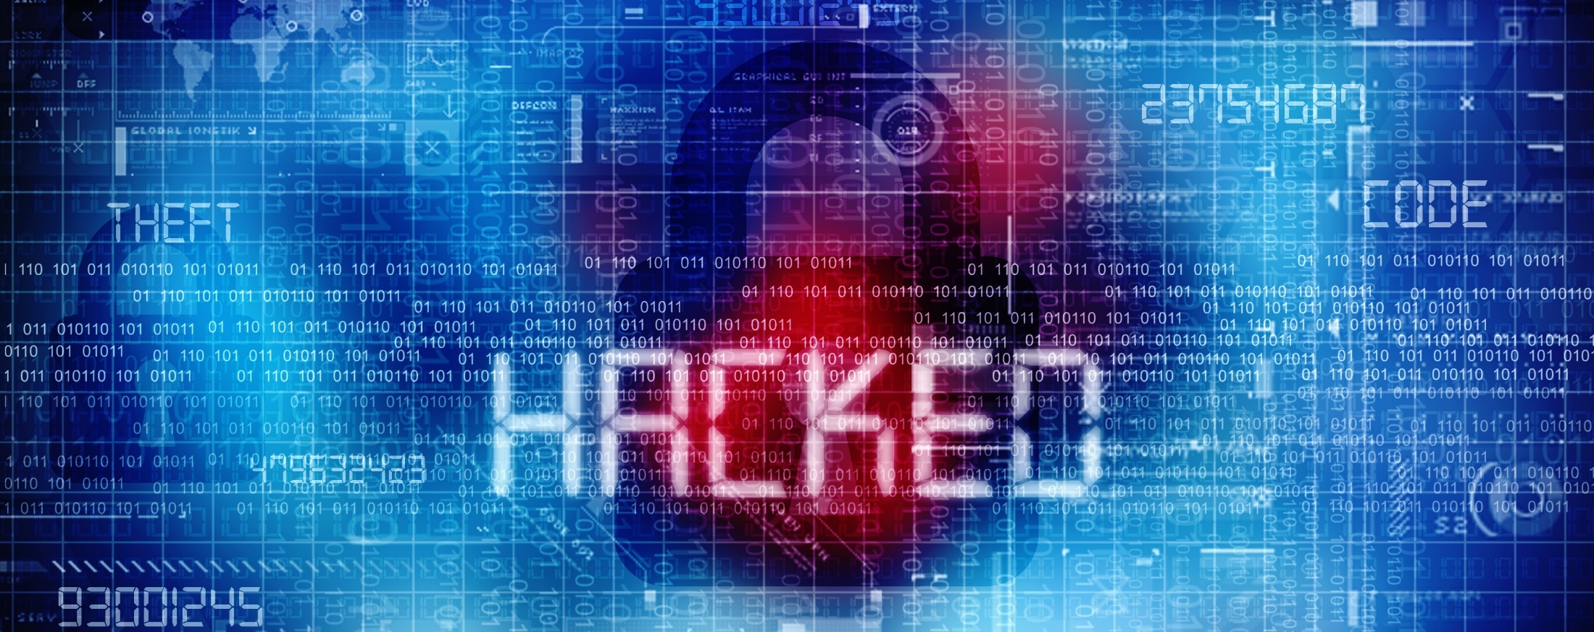
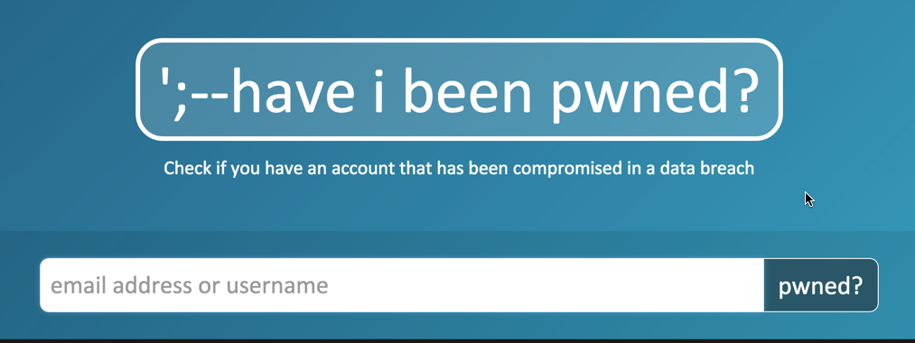
Reason #2: Data Leakage
Customer data floating around
haveibeenpwned.com
Notes:
Reason #2 is data leakage. The last time I checked your customers would rather not have their personal information spread out all over the Internet. When systems aren't hardened, vulnerabilities can be exploited, and data can easily be stolen right out from under your nose. I've read numerous reports about breaches that ar discovered YEARS after the fact.
***This site, haveibeenpwned.com is a site that goes out and collects the dumps from all of these data breaches and merges them all into one massive database. It then gives you the ability to look up your email address to see if it's been part of a data breach. If found, it will then show you what data breach incident that email came from.
This is NOT what you want your customers going to and finding out that their personal information was leaked to the Internet because your systems were not hardened. It looks bad not only on IT but the entire company. There have been CEOs fired because of data breaches. This is how high profile these events can be.

Slide 8
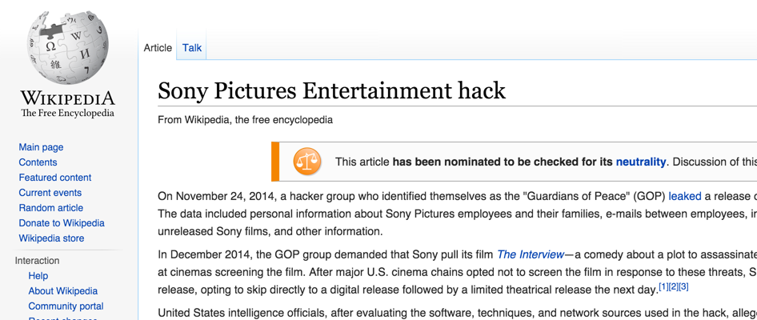
Reason #3: PR Nightmares
Notes:
How would you like your company to have a Wikipedia page forever online as a remembrance of the inadequacies of your system hardening procedures? Not me. I don't want to be the IT manager that doesn't implement a tool to monitor vulnerable security settings on his servers because it's deprioritized.
Security software is like insurance. You hate to spend the money on it because, right now, it's not providing any value. In fact, it can sometimes bring negative value in the form of unforeseen downtime when a patch is installed on a system or a critical user account is disabled that wasn't thought to be of any use anymore. We've all been there, and we've probably all been burned by some change that security has needed us to do or only just patching a system has brought it to its knees.
However, as you can see from Sony's PR nightmare, like insurance, it's well worth taking the time, getting it right and taking the slight risk of some downtime now and then. I'd much rather a production server go down and my customers not able to access a service rather than having their information spread out on the Internet for all the world to see.
You'll see near the end of this webinar; some tools can substantially decrease the chance of downtime when implementing these system hardening configuration changes.

Slide 9





How to Harden Servers 101
1. Reduce attack surface
2. Discover vulnerabilities
3. Build test environment
4. Apply change in production
5. Pray nothing breaks
6. Keep it hardened
Notes:
So now that I've convinced you.....and I have convinced you, right? ...so now that I've convinced you of just three of the reason to harden your systems, here's six steps on how to make it happen
***Step #1 is to reduce your attack surface. When you provision a new server, eliminate as many features as possible and do not install any software that's of no use by whatever service that server was built for. By simply reducing everything you can, this naturally reduces the attack surface of the system and provides fewer ways for an attacker to exploit any vulnerabilities on there. Less "stuff" typically means fewer vulnerabilities.
***Step #2 is to discover vulnerabilities. This can be done in some different ways. Whether you use a tool like Nessus, Qualys or one of these others, or you're just using something like Windows Server Update Services to measure patch levels on your Windows systems, you must first know the kind of attack surface you're working with once you've whittled it down to as small as possible.
***Step #3 is to build a test environment. I don't have to tell you it's not necessarily good practice to test in production. You'll need to provision some environment in a segmented off place on your network to test changes. The complexity of this sometimes leads some admins to skirt the system and slip in little production changes here and there. This is a recipe for disaster. This small change might be a dependency for ten other applications that you didn't know about.
***Step #4 is to apply the change in production. So you've tested it out in an environment that you think looks like production and you're good with it. It's now time to wait for the change window and do it.
...which leads us to Step #5 what I call the religious phase. Once you flip the switch, it's do or die time and depending on the severity can be a nerve-wracking experience. If you're religious, you might say a few words during that change window and cross your fingers that your simple change doesn't cause a chain reaction of destruction.
***Finally, step #6: keep it hardened. This is, by far, the hardest part to do. You can make the change in production without repercussion but what about two years from now? By then, that change has been forgotten amongst the hundreds of other projects on your plate that have come and gone. This is where an automated tool must be implemented. An automated tool can be monitoring that change 24/7, and as soon as it changes state, it can be reverted or alerted on. This last step is what separates good IT from great IT.

Slide 10
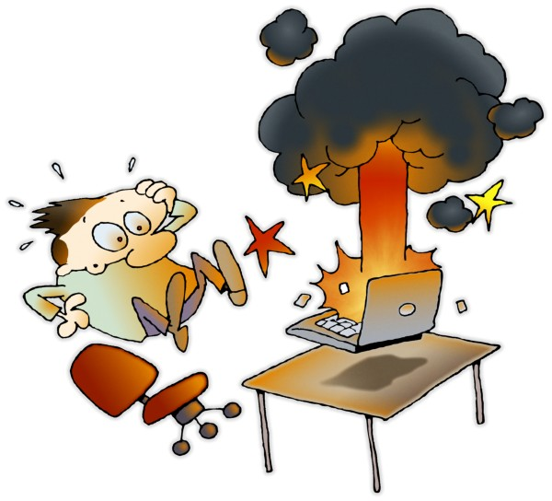
Production is Down!
Notes:
You've hardened your systems, now look what you did! Production is down! Everyone's running around with their hair on fire while the sky is falling. Well, it might not be THIS bad, but it does get pretty stressful when you've got a hovering manager asking you every 5 minutes when the system is going to be back up.
THIS is what we're trying to prevent here, and this is why system hardening and various security measures are overlooked. It's because we're all afraid to make changes to critical production systems because we're not quite ready to risk the gauntlet of criticism when a change we perform ends up causing...let's say...unforeseen circumstances.

Slide 11

IT operations vs. Security
Do it!
No!
Notes:
Here's another problem: Operations is put up against the security team. ***The security team's job is to recommend and enforce policy across the environment. It's operations job to implement those changes. If the changes themselves are too risky and have the potential of making operations look bad, I don't blame them for not liking it.
***Operations has to stick their neck out for security and be the ones to make the change. And you know as well as I, it's typically the person that made the change is the one to catch the blame for the change.
If we could take most of the risk out of a system hardening procedure, operations would be more inclined to make a change the security team recommended and just maybe start going to lunch with each other again.

Slide 12

Hardening is Hard
Time intensive
Hard to monitor
Expensive
Notes:
System hardening is not easy. If it were, there'd sure be a lot fewer reports on the news about company data being stolen or held for ransom.
System hardening, especially in large enterprises, ***is time intensive. It takes time to go through all the steps I outlined earlier. Just bringing up a clean test environment can take days or weeks if you have to get other people involved. Not only that if you bring up a test environment that mirrors production today, but it's also probably not going to reflect production exactly tomorrow. Then requires the task of keeping the two in sync which is a whole other argument.
***Next, hardening is hard to monitor. As I mentioned earlier, a change is easy to make now but not so easy to keep an eye on to ensure it stays that way.
***Finally, this all leads to significant costs both regarding potential downtime as well as human capital. If everyone is just ad-hoc tweaking things to harden systems without any real strategy, it's going to take a lot of time and a lot of human mistakes are going to have to be corrected which is costly.
You need a tool that can not only make these changes for you but also to act as a monitor to ensure the hardening configuration item you changed now stays that way.

Slide 13



Hardening Methods
GPO
Configuration management products
Scripts
Calcom Software
Notes:
So how do you go about hardening your servers? First, when it comes down to it, hardening is just changing a configuration. It is about tweaking settings on servers to make them more secure. The hard part is understanding what to change. You can find hardening guides out there as well as various products to help you in this endeavor if you simply Google server hardening. You'd be surprised of the documentation you will find.
Once you know the settings you need to change you'll then need a tool actually to go out and make those changes. You've got a few different options; four of those I'll discuss now. If you've got Window servers, a great way to harden your servers is through ***GPOs. GPOs give you a slew of various options you can change on your server infrastructure at once. GPOs are nice because they are built into Windows but can become problematic when they become too complicated. I've personally had times when an organization has built up hundreds of GPOs over time and it's tough to decipher which GPOs has precedence under which circumstance.
The next is ***configuration management products. These are products that were specifically designed to change various configurations on your servers and keep them this way. These kinds of tools like Chef, Puppet, Ansible and the like are great for defining a set of configuration items and target specific servers. However, these tools typically aren't free and require some training time to get up to speed. They also aren't system hardening specific either. You'll have to figure out how to map your hardening strategy to the tool.
Next is ***ad-hoc scripts. Scripting has been around for a long time, and you can technically do anything with scripts you can do with these tools. However, scripts have a significant disadvantage of not typically being used for large environments. They are hard to organize and eventually become unwieldy if you've got hundreds of scripts spread throughout your organization changing this and that setting.
***Finally, we come to a tool that Calcom Software produces. This is a tool designed specifically for system hardening. It provides a one-stop-shop for all of your system hardening needs from suggesting settings to change, testing the changes, making the changes and keeping them that way.

Slide 14

Password Change Scenario
Scheduled tasks
Windows services
Logged in users
Notes:
Let's now dive a little deeper and discuss a few real scenarios that you might find yourself in.
The fist scenario is the password change scenario. A password change to a user is no big deal. They simply hit Ctrl-Alt-Delete, change password and they're now using a new password. A password change for an account can be the complete opposite if you're in IT especially if it's a privileged account.
One primary hardening recommendation is to enable a policy called "Network Security: Do not store LAN Manager hash value on next password change." This is a policy that, although, great for security since the password hash isn't stored on the local machine thus potentially being exposed. However, on the other hand, if the hash isn't stored locally and an application has been configured to use the old password, it can break.
A good example of this is a scheduled task. When you build a scheduled task you can either choose to run it as a domain user which saves the hash, as SYSTEM which doesn't save the hash or as a local user which doesn't save the hash. To ensure an application doesn't break you need to account for details like this. I don't know about you, but there's been many times in my career where I've configured a scheduled task to use a domain user account and forgotten about it. That is until the password was changed.

Slide 15

Dependencies Galore
Notes:
Have you ever considered just how many dependencies exist in the simplest application? Even with the smallest of application configurations you might just have a single machine hosting a web server and perhaps a database or two. In this scenario, you've got dependencies like the website depending on the database, the website depending on particular database tables, the database depending on resources from the server, the database's security logins and all the other minutiae that come with a particular component. There are dependencies galore!
Luckily, the software developers sometimes prevent us from doing something stupid by accounting for these dependencies in the software itself. But there's no way for them to foresee the crazy environments their software is going to be installed in. It's up to us to account for these dependencies on our own. This is no easy task.

Slide 16
Dependency Scenarios
Windows services
Dealing with anonymous
Notes:
To solidify this problem, again, let's talk about some real-world scenarios of where this might apply.
***The first is around Windows services. A typical hardening task is to stop or disable Windows services. This shuts down an executable program and potentially closes an open port or more on the machine's network stack. However, do you know what's depending on that service? Usually, the service isn't the same name as a familiar application, and the only true way to know is to look at each application's configuration to find out. One that sticks out in my head is when I restarted the W32_Time service on a server once and found out that it took the entire Windows cluster down because it got out of sync.
Also, what about services depending on one another. This is easier to spot since it usually comes up when you try to stop a service but wouldn't it be nice if you could see all these dependencies ahead of time?
***Another dependency scenario is the usage of anonymous. Anonymous usage can be made in lots of different places from IIS application pools or indirectly by DCOM or other pieces of software.
Anonymous could be in the service or far from it. It's tough to detect all transactions using the anonymous account. You have no real way to identify what's using this anonymous account until you disable it and find out the hard way.
On top of that, if you ever look in a group policy object under security you'll find up to 8 different policies all making reference to anonymous.

Slide 17

Red Tape Testing
Change management
Approvals
Test environments, which leads to...
Notes:
Another widespread problem with testing is what I called red tape testing. This involves all of the hoops you must jump through to get a change put into production. This is where our friend ***change management comes into play. If you work in a large enterprise, you probably know what I'm talking about. You submit a change ticket, wait a week and then ***get approval for a change window in another week. It's a frustrating experience.
This is necessary due to the complexity of systems but doesn't have to be quite so painful. If your organization can show the testing procedures you're going through before asking for a change in production are sound, you might get some leeway here.
***Testing is not only necessary regarding merely ensuring nothing breaks but good; thorough testing always gives you more credence as well. If you're able to prove that your testing procedures are well thought out and cover as many potential problems as possible, you will become trusted and can sometimes get changes into production faster.

Slide 18

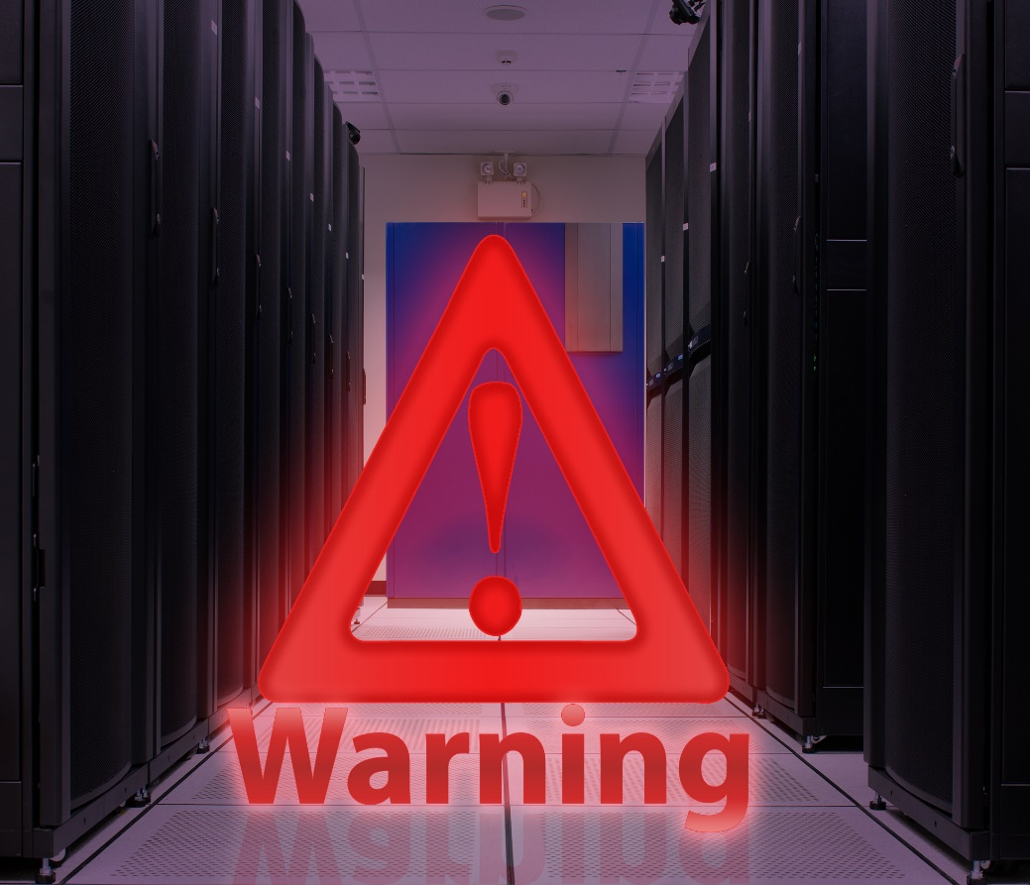



The Result of Typical Server Hardening
Notes:
This is the typical result of server hardening initiatives. Since system hardening can easily affect production services, ops hates to make changes, but it is security's job to recommend and enforce the changes. Sometimes it can end up in a stalemate where your infrastructure is wide open and vulnerable to different attacks.
It a damned if you do or damned if you don't kind of situation. Everyone knows what they need. Better security. However, no one wants to make the changes to make it happen for fear of affecting production services.
Since it is so hard to replicate production in a testing environment and sometimes takes weeks just to get an environment up at all, some just skip the test environment completely.

Slide 19
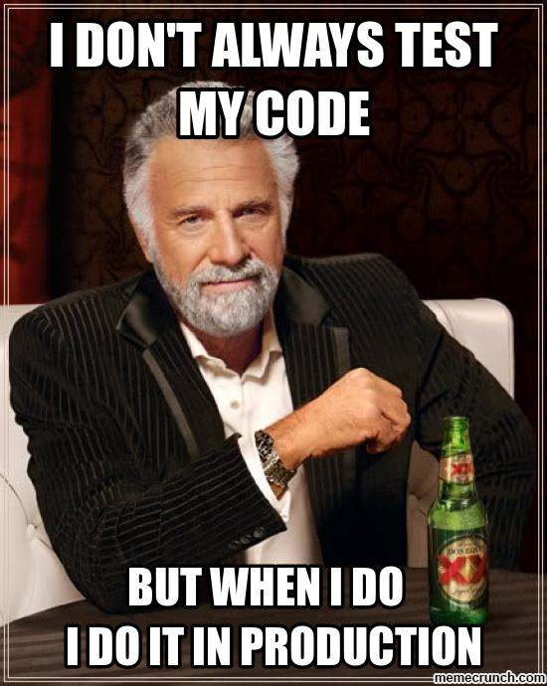
Testing in Production
You know you've done it
Forced to take shortcuts
Notes:
Don't lie. ***You know you did this at least once in your career. Some of you impatient ones more than others. I have many times, and it has burned me. It wasn't because I didn't care about affecting production it was that I simply had too many things on my plate and I felt like I couldn't wait.
The testing process was way too time-consuming and at the pace our team was going, ***it simply wasn't feasible to adhere to the company-mandated testing process. You've got conflicting priorities, and sometimes you accept the risk to make your boss happy. Usually, you are OK, but sometimes it can be catastrophic.
You are playing with fire when you test in production. It is like rolling the dice. Sometimes you are a winner and sometimes you are a loser. It is all about managing risk.

Slide 20

Synthetic Production
Actually testing in production
Known dependencies
Faster testing
Happy IT
Notes:
What is the cure for system hardening and testing? I'm not sure there is a magic pill. The problem stems from the disparity between test and production. We've all been trying to build these test islands that represent production as close as possible, but it will never be the same. Production is too dynamic, and you'd be forced to build test servers every minute during the day to keep up.
Believe it or not, an excellent solution is actually to test in production but not how you might think. ***It's something like a synthetic production environment. Think of it as sort of like a layer on top of production that can be manipulated.
For example, what if you could have a tool that ***knew all of your application's dependencies? It could find out if you changed registry settings, which might affect a service on an entirely different server or stopped a service which would affect something else in a totally different datacenter all together?
I'm talking about something that essentially IS production but allows you to perform routine system hardening procedures without actually changing anything in the "real" production environment.
This would not only give us ***better testing procedures because an automation tool will be keeping track of all dependencies that us humans will forget but it's also testing on production; not in a separate testing environment. This also saves a ton of time which results in more thorough testing procedures and addresses security risks much faster.
***Now, this would lead to a much happier IT department all the way around.

